Slide 1

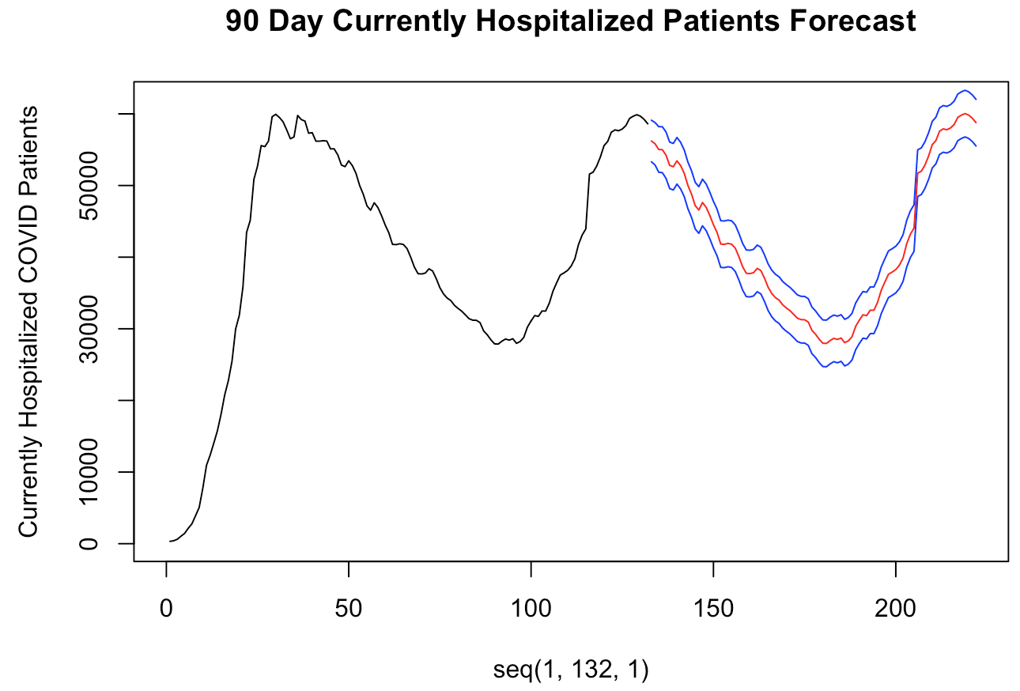
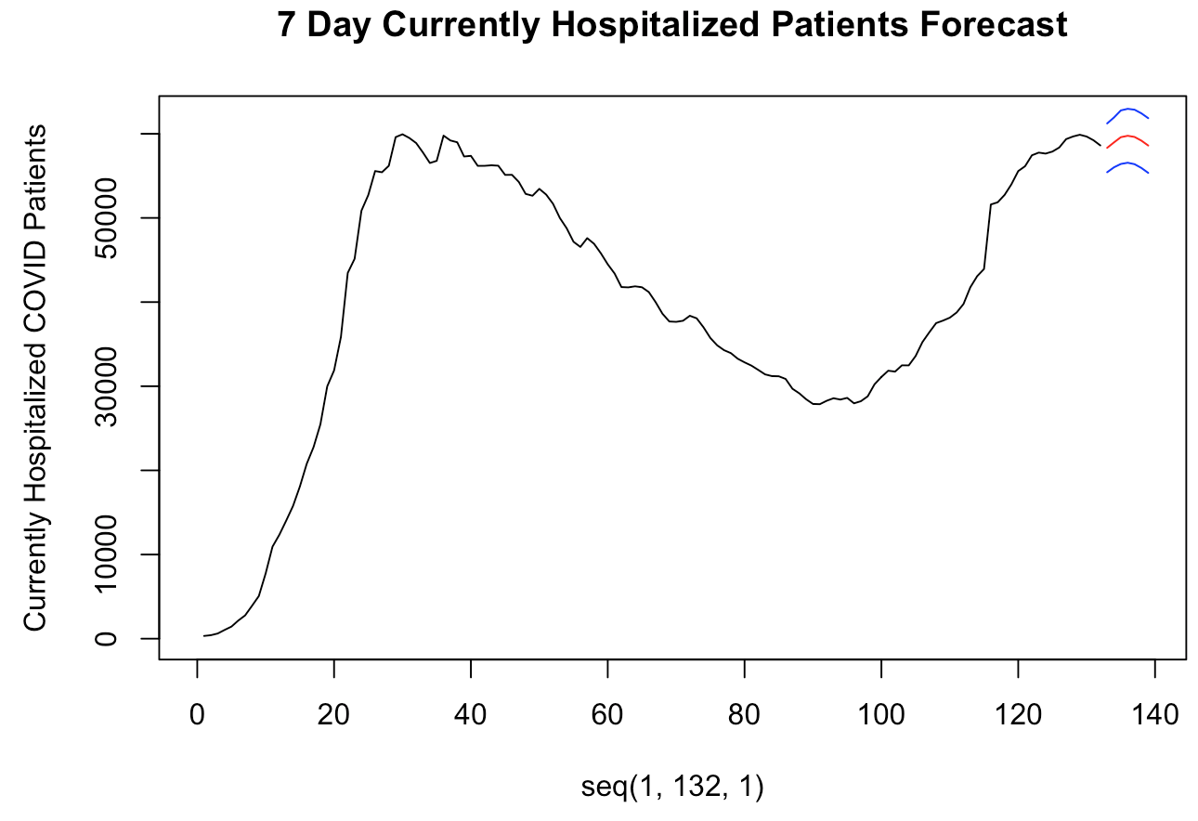

United states
Vector autoregression model
7-Day ASE
25,178.55
90-Day ASE
10,791.59
Notes:
Jaclyn Notes
Time: 21 seconds
Nest we built vector autoregression models. They are difference predictions that are back calculated for predictions and prediction intervals. This is a useful model because it is based off of previously observed metrics. While this can be useful in a short term forecasts, we easily saw that our long term forecast would be dependent on the hospitalization cases following the same pattern and that would be highly unlikely in the case of a novel virus.

